Slide 1
An Overview of Cryptography (Part III)

Slide 2
Public Key Certificate
Also known as Digital Certificate
An electronic file that confirms the identity of the server (the certificate subscriber/holder)
Provide a way of authentication: to prove who they claim to be
For example, when we visit a bank’s web site, we can check the digital certificate provided by the server to see if it is a legitimate web site or a forged web site (owned by the hacker instead)
Contain the certificate holder’s public key, which can be used by the client for further actions, such as digital signature and key exchange
Prove the ownership of the public key
Notes:
Demo

Slide 3
A digital certificate is issued by a Certification Authority (CA)
Example: DigiCert, Comodo, Go Daddy Group, GlobalSign, VeriSign, Hongkong Post
A CA acts as a trusted third party to verify the identity of certificate subscriber
A server can also create a certificate by itself (a self-signed certificate), but this will probably cause the client’s browser to display a warning message since the browser does not know whether this certificate can be trusted
A self-signed certificate is less trusted than a certificate issued by a trusted CA

Slide 4
X.509 Authentication Service
X.509 is a standard defining the format of public-key certificate associated with each user.
The X.509 certificate format is widely used, such as in SSL/TLS, S/MIME, IP Security, and SET.
These user certificates are assumed to be created by some trusted CAs and placed in the directory by the CA or by the user.

Slide 5
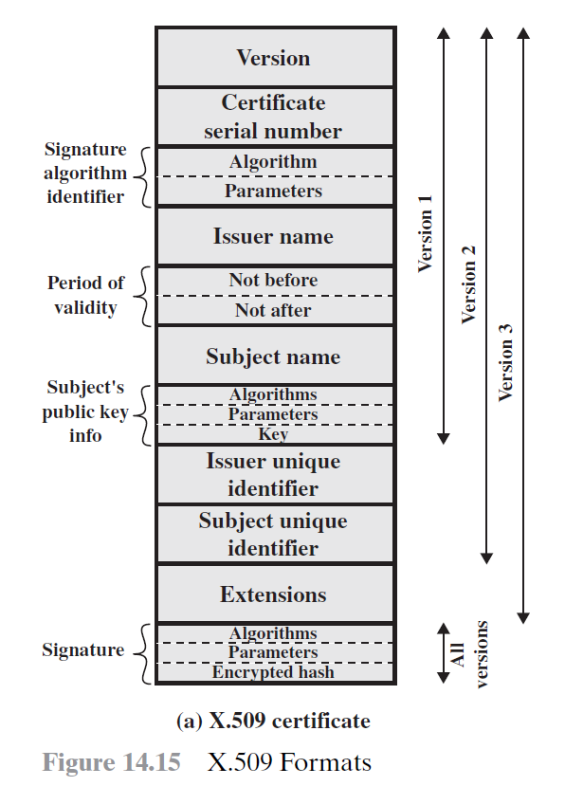
Image source: Stallings, Cryptography and Network Security: Principles and Practice (6th Edition)
Notes:
Demo

Slide 6
Suppose a client trusts a CA
The client obtains the certificate of this CA, say cert_{CA}
Browsers (or OSs) pre-install the certificates of the CAs they trust
The user can also manually download the certificates of the CAs from the CAs’ websites
cert_{CA} contains the public key of CA
This public key will be used for verification
Further suppose the client visits a server, say S, with the certificate issued and signed by CA, say cert_{S}
The client obtains cert_{S} from S
The client verifies cert_{S} by the public key of CA and know that cert_{S} is indeed issued and signed by CA
From cert_{S}, the client can obtain the public key of S
Notes:
Demo

Slide 7
Certificates are not just for web servers
Individual users can also apply for digital certificates
Characteristics of certificates generated by a CA
Any users with access to the public key of the CA can obtain the public keys of the users that were certified by the CA.
No parties other than the CA can modify the certificate without being detected.
All users who subscribe to the same CA have the common trust to that CA.
All user certificates can be placed in the directory for access by all other users.
Since the number of users is huge, it is more practical to have more than one CA.
In practice, each CA provides its public key to some fractions of the users

Slide 8
Problem
Suppose
User A obtains a certificate from CA X₁
User B obtains a certificate from CA X₂
If A does not know the public key of X₂, then A cannot decide whether B’s certificate can be trusted
Solution
If the two CAs have securely exchanged their public keys, A can obtain B’s public key.
A obtains X₂’s certificate signed by X₁
Then A can obtain X₂’s public key.
Hence A can verify the certificate of B signed by X₂.
The chain is X₁<<X₂>>X₂<<B>>
where CA<<U>> = the certificate issued by CA to user U
Similarly, B can obtain A’s public key X₂<<X₁>>X₁<<A>>

Slide 9
In general, a chain with N elements can be expressed as
X₁<<X₂>>X₂<<X₃>>…..X_{N}<<B>>
All these certificates of CAs by CAs need to appear in the directory, and the user needs to know how they are linked to follow a path.
The directory of CA X includes two types of certificates.
Forward certificates
Certificates of X generated by other CAs
Example: W<<X>> (see next page)
Reverse certificates
Certificates of other CAs generated by X.
Example: X<<W>> (see next page)
X.509 suggests that CAs be arranged in a hierarchy so that navigation is straight forward.

Slide 10
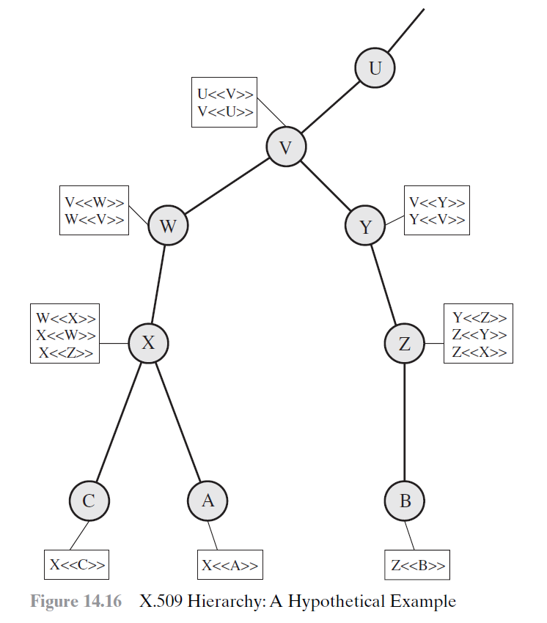
The connected circles indicate the hierarchical relationship among the CAs
The associated boxes indicate certificates maintained in the directory for each CA entry.
Image source: Stallings, Cryptography and Network Security: Principles and Practice (6th Edition)
Notes:
Suppose A obtains a certificate from B and does not know whether the certificate can be trusted:
Certification path from A to B: X<<W>>W<<V>>V<<Y>>Y<<Z>>Z<<B>>
Suppose B obtains a certificate from A and does not know whether the certificate can be trusted:
Certification path from B to A: Z<<Y>>Y<<V>>V<<W>>W<<X>>X<<A>>

Slide 11
Suppose A obtains a certificate from B and does not know whether the certificate can be trusted:
Certification path from A to B
X<<W>>W<<V>>V<<Y>>Y<<Z>>Z<<B>>
Suppose B obtains a certificate from A and does not know whether the certificate can be trusted:
Certification path from B to A
Z<<Y>>Y<<V>>V<<W>>W<<X>>X<<A>>

Slide 12
Revocation of certificate
Certificate may be revoked because
The user’s private key is assumed to be compromised.
The user is no longer certified by this CA.
The CA’s certificate is assumed to be compromised.
Each CA must maintain a list consisting of all revoked but not expired certificates issued by that CA.
Users could check the directory each time a certificate is received.
Users may maintain a local cache of certificates and lists of revoked certificates.

Slide 13
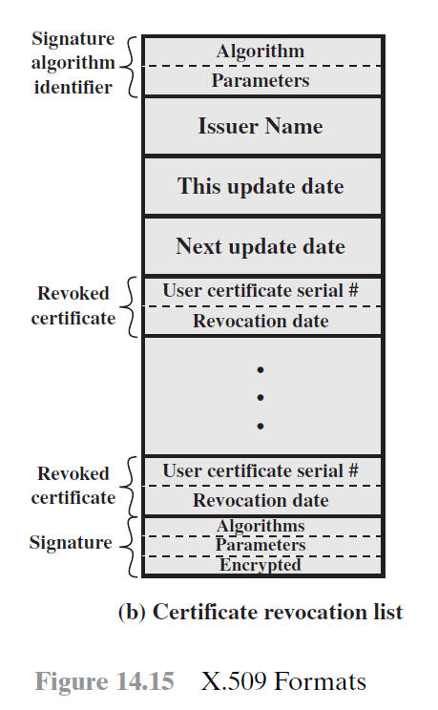
Image source: Stallings, Cryptography and Network Security: Principles and Practice (6th Edition)

Slide 14
Secure Socket Layer (SSL)
SSL was originated by Netscape.
Version 3 of the protocol was designed with public review and input from industry.
It is designed to make use of TCP to provide a reliable end-to-end secure service, such as for HTTP, FTP, and SMTP
HTTPS: HTTP over SSL
Also stands for HTTP Secure or HTTP over TLS (see later slides)
FTPS: FTP over SSL
Note that FTPS is different from SFTP, which stands for Secure File Transfer Protocol or SSH File Transfer Protocol

Slide 15
Two important SSL concepts
Session
An association between a client and a server.
Created by the handshake protocol.
Define a set of cryptographic security parameters, which can be shared by multiple connections.
Connection
A connection is a transport that provides a suitable type of service.
Connections are transient.
Every connection is associated with one session.

Slide 16
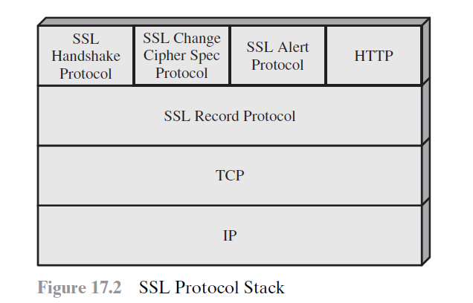
SSL consists of two layers of protocols.
The SSL Record Protocol
Provides basic security services to various higher layer protocols.
SSL-specific protocols
Handshake protocol.
Change Cipher Spec Protocol
Alert Protocol.
Image source: Stallings, Cryptography and Network Security: Principles and Practice (6th Edition)

Slide 17
SSL Record Protocol
Provide two services
Confidentiality
The handshake protocol defines a shared secret key that is used for conventional encryption of SSL payload
Message Integrity
The handshake protocol also defines a shared secret key that is used to form a Message Authentication Code (MAC).
Image source: Stallings, Cryptography and Network Security: Principles and Practice (6th Edition)

Slide 18
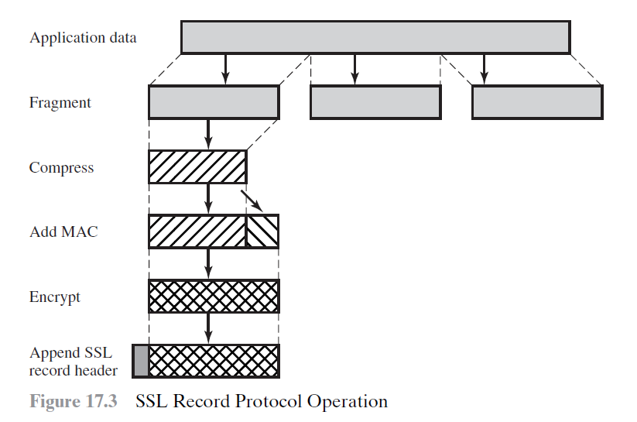
(optional)
Image source: Stallings, Cryptography and Network Security: Principles and Practice (6th Edition)

Slide 19
Handshake protocol
Allows the server and the client to authenticate each other.
To negotiate an encryption and MAC algorithm and cryptographic keys.
Four phases:
Establish Security Capabilities
Server Authentication and Key Exchange
Client Authentication and Key Exchange
Finish
See diagram on the next page
Image source: Stallings, Cryptography and Network Security: Principles and Practice (6th Edition)

Slide 20
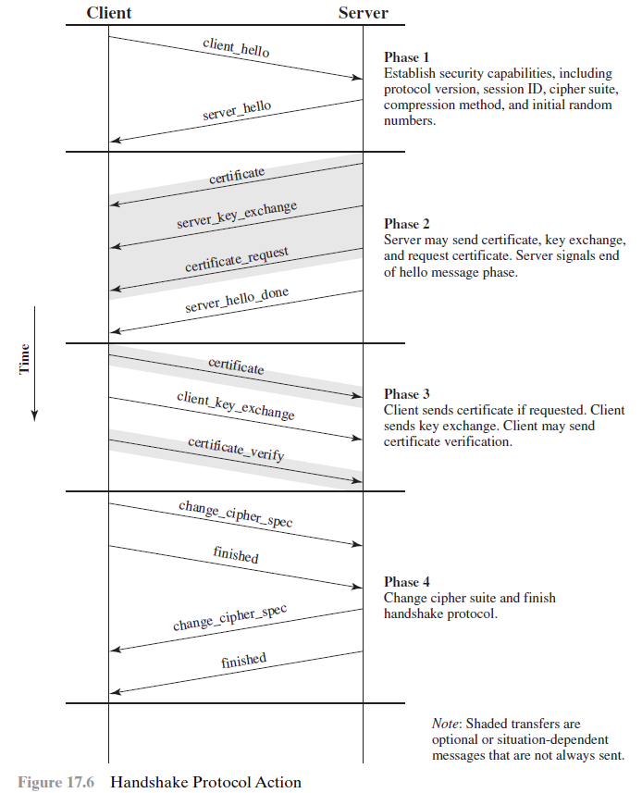
Image source: Stallings, Cryptography and Network Security: Principles and Practice (6th Edition)

Slide 21
Phase 1: Establish Security Capabilities
Initiate a logical connection and establish the security capabilities associates with it.
The client initiates with a client_hello message with
Version
The highest SSL version understood by client
Random (consist of a timestamp and a random number)
Prevent replay attack.
Session ID
Session identifier
cipherSuite
List of cryptographic algorithms supported by the client.
Compression Method
List of compression methods supported by the client.

Slide 22
The server replies with a server_hello message with
Version
The highest SSL version understood by both sides
Random (consist of a timestamp and a random number)
Prevent replay attack.
Session ID
Session identifier
cipherSuite
Choose the strongest cryptographic algorithm supported by both sides
If no algorithm is supported by both sides, end the session with a handshake failure alert
Compression Method
Specify the compression method (if any)

Slide 23
Phase 2: Server Authentication and Key Exchange
Server sends certificate if necessary
The message contains one or a chain of X.509 certificates.
Required for any agreed-on key exchange.
Send server_key_exchange message if necessary
Not required in some cases such as when certificate already contains necessary information
Send certificate_request message if necessary
Request the client to send its own certificate
Certificate_type
Indicates the public-key algorithm and its use.
Certificate authorities
A list of the distinguished names of acceptable certificate authorities.
Send server_done message
Notes:
https://technet.microsoft.com/en-us/library/cc783349(v=ws.10).aspx

Slide 24
Phase 3: Client Authentication and Key Exchange
The client will first validate the certificate and the parameters in the server_hello message.
Send certificate if it is requested by server.
Send client_key_exchange message
Must be sent in this phase
The content depends on the type of the key exchange
If certificate already contains necessary information, this message will be null
Send certificate_verify message if necessary
Provide explicit verification of the client’s certificate
To avoid someone misusing the client’s certificate
Verify the client’s ownership of the private key for the client certificate, which contains the public key
By signing a hash code based on the preceding messages
Notes:
https://technet.microsoft.com/en-us/library/cc783349(v=ws.10).aspx

Slide 25
Phase 4: Finish
The client sends change_cipher_spec message
Consists of a single byte with value 1.
At this point, the client switched to the agreed cipher suite
Client sends finish message
Under the agreed algorithms, key, and secrets
Verifies that the key exchange and authentication processes were successful.
Server send change_cipher_spec message
Server sends its finished message.

Slide 26
Transport Layer Security (TLS)
In 2014, SSL 3.0 is found to be vulnerable to the POODLE attack (a kind of MiM attack) and is considered broken.
We should use Transport Layer Security (TLS) instead
TLS 1.0 is an upgrade of SSL 3.0 with similar functionalities, with some differences in:
MAC scheme
Alert code
Cipher suite
Client certificate type
Cryptographic computation
Padding
Sometimes, TLS 1.0 is referred to as SSL 3.1
Notes:
https://tools.ietf.org/html/draft-ietf-tls-tls13-19
https://www.acunetix.com/blog/articles/tls-vulnerabilities-attacks-final-part/
https://www.clickssl.net/blog/an-easy-to-understand-guide-ssl-tls-https-ssl-certificate-and-https
Stallings, Cryptography and Network Security: Principles and Practice (6th Edition)

Slide 27
However, some of the TLS 1.0 / 1.1 implementations are still vulnerable to the POODLE attack
We should at least use TLS 1.2
The most popular version nowadays
But a server that is not configured properly is still vulnerable to attacks
The latest version is TLS 1.3
Approved by The Internet Engineering Task Force (IETF) in 2018
More secure than TLS 1.2
Remove the support of old and broken cryptographic primitives
E.g., RSA (for key exchange), SHA-1, MD5
Mandate forward secrecy
Faster to establish a secure connection than TLS 1.2
Reduce the number of round-trips for handshake from 2 to 1
2-RTT → 1-RTT
Support 0-RTT for previously established connections
At the cost of weaker security
Notes:
https://tools.ietf.org/html/draft-ietf-tls-tls13-19
https://www.acunetix.com/blog/articles/tls-vulnerabilities-attacks-final-part/
https://www.clickssl.net/blog/an-easy-to-understand-guide-ssl-tls-https-ssl-certificate-and-https
Stallings, Cryptography and Network Security: Principles and Practice (6th Edition)
https://www.wolfssl.com/docs/tls13/

